Slide 1
Algoritmi de sortare
Cocu Matei-Iulian
Lăutaru Bianca-Maria

Slide 2
Cuprins
01
02
04
05
03
Heap Sort
Merge Sort
Shell Sort
You can describe the topic of the section here
You can describe the topic of the section here
You can describe the topic of the section here
06
Quick Sort
Radix Sort
? Sort
You can describe the topic of the section here
You can describe the topic of the section here
You can describe the topic of the section here

Slide 3

01
Heap Sort
Sortare folosind heap

Slide 4
Heap Sort
Heap Sort este un algoritm de sortare bazat pe comparare, care folosește o structură de date de tip heap (un arbore în care fiecare nod este mai mare decât fiii lui), eliminând repetat cea mai mare valoare și plasând-o la finalul array-ului.
Complexitatea de timp:
Worst-case: O(n log n)
Average: O(n log n)
Complexitatea de spațiu:
Total: O(n)
Suplimentar: O(1)
unde n = numărul de elemente

Slide 5
02
Merge Sort
Sortare prin interclasare

Slide 6
Merge Sort
Merge Sort este o metodă eficientă de sortare a elementelor unui tablou, bazată pe următoarea idee: dacă prima jumătate a tabloului are elementele sortate și a doua jumătate are de asemenea elementele sortate, prin interclasare se va obține tabloul sortat.
Complexitatea de timp:
Worst-case: O(n log n)
Average: O(n log n)
Complexitatea de spațiu:
Total: O(n)
Suplimentar: O(n)
unde n = numărul de elemente

Slide 7
03
Shell Sort
Sortare

Slide 8
Shell Sort
Shell Sort este un algoritm de sortare in-place care poate fi considerat o generalizare a algoritmului Insertion Sort. Ideea de bază este de a sorta perechi de elemente care se află la o distanță mai mare, reducând apoi treptat această distanță.
Complexitatea de timp:
Worst-case: O(n²)
Average: O(n log n)
Complexitatea de spațiu:
Total: O(n)
Suplimentar: O(1)
unde n = numărul de elemente

Slide 9
04
Quick Sort
Sortare rapidă

Slide 10
Quick Sort
Quick Sort este un algoritm bazat pe metoda Divide et Impera care alege un element ca pivot și îl plasează în poziția sa corectă din array-ul sortat, toate elementele mai mici decât el fiind în stânga și toate cele mai mari, în dreapta. Alegerea pivotului influențează timpul de execuție.
Complexitatea de timp:
Worst-case: O(n²)
Average: O(n log n)
Complexitatea de spațiu:
Total: O(n)
Suplimentar: O(n)
unde n = numărul de elemente

Slide 11
05
Radix Sort
Sortare prin compararea cifrelor

Slide 12
Radix Sort
Radix Sort este un algoritm de sortare care nu se bazează pe comparare. Numerele sunt distribuite repetat în bucketuri în funcție de valoarea fiecărei cifre, de la dreapta la stânga. În funcție de baza aleasă pentru procesarea numerelor, poate fi mai lent sau mai rapid.
Complexitatea de timp:
Worst-case: O(d * (n + b))
Average: O(d * (n + b))
Complexitatea de spațiu:
Total: O(n + b)
Suplimentar: O(n + b)
unde n = numărul de elemente,
d = numărul de cifre al celui mai mare număr și b = baza

Slide 13
06
? Sort
Sortare prin ?

Slide 14
? Sort
? Sort este
Complexitatea de timp:
Worst-case: O(?)
Average: O(?)
Complexitatea de spațiu:
Total: O(?)
Suplimentar: O(?)
unde

Slide 15

—Someone Famous
“This is a quote, words full of wisdom that someone important said and can make the reader get inspired”

Slide 16
Concepts
Mercury
Venus
Mercury is the closest planet to the Sun and the smallest one in the Solar System—it’s only a bit larger than the Moon
Venus has a beautiful name and is the second planet from the Sun. It’s hot and has a poisonous atmosphere

Slide 17
What is this topic about?
Mercury
Venus
Mars
It’s the closest planet to the Sun and the smallest in the Solar System
Venus has a beautiful name and is the second planet from the Sun
Despite being red, Mars is actually a cold place. It’s full of iron oxide dust

Slide 18
Features of the topic
Mars
Neptune
Despite being red, Mars is very cold
It’s the farthest planet from the Sun
Jupiter
Saturn
Jupiter is the biggest planet of them all
Saturn is a gas giant and has several rings

Slide 19



Examples
Mercury
Venus
Mars
It’s the closest planet to the Sun and the smallest in the Solar System
Venus has a beautiful name and is the second planet from the Sun
Despite being red, Mars is actually a cold place. It’s full of iron oxide dust

Slide 20
Recommendations
Mars
Venus
Neptune
Despite being red, Mars is very cold
Venus is the second planet from the Sun
Neptune is the farthest planet from the Sun
Mercury
Saturn
Jupiter
Mercury is the closest planet to the Sun
Saturn is a gas giant and has several rings
Jupiter is the biggest planet of them all

Slide 21

Image always reinforce
the concept
You can give a brief description of the topic you want to talk about here. For example, if you want to talk about Mercury, you can say that it’s the smallest planet in the entire Solar System

Slide 22
4,498,300,000
Big numbers catch your audience’s attention

Slide 23
9h 55m 23s
333,000
386,000 km
Jupiter’s rotation period
The Sun’s mass compared to Earth’s
Distance between the Earth and the Moon

Slide 24
Awesome words

Slide 25

A picture is worth a thousand words

Slide 26
Practical exercise - calculator
Objective:
Introduce participants to basic coding concepts by building a simple calculator
Instructions:
Open a Python development environment and write the following code:
# Simple Calculator
num1 = int(input("Enter the first number: "))
num2 = int(input("Enter the second number: "))
print("Sum:", num1 + num2)
print("Difference:", num1 - num2)
print("Product:", num1 * num2)
print("Quotient:", num1 / num2)
Run the program and experiment with different numbers
Observe the output

Slide 27
Brainstorm and idea generation
Mercury
It’s the smallest planet of them all
Earth
Venus
Venus is the second planet from the Sun
Power 1
Neptune
It’s the farthest planet from the Sun
Mars
Saturn
Saturn was named after a Roman god

Slide 28
Main topic and details
Mars
Neptune
Despite being red, Mars is very cold
It’s the farthest planet from the Sun
Jupiter
Saturn
Jupiter is the biggest planet of them all
It’s a gas giant and has several rings

Slide 29
Popular programming languages
01
Neptune
Mercury is the closest planet to the Sun and the smallest of them all
02
Venus
Venus has a beautiful name and is the second planet from the Sun
03
Earth
Earth is the third planet from the Sun and the only one that harbors life in the Solar System
04
Saturn
Saturn is a gas giant and has several rings. It’s composed mostly of hydrogen and helium

Slide 30
Sequences
Saturn is composed of hydrogen and helium
Mercury is the closest planet to the Sun
Jupiter was named after a Roman god
First
Next
Next
Next
Next
Last
Despite being red, Mars is very cold
Earth is the third planet from the Sun
Venus has extremely high temperatures

Slide 31
Classification
Mars | Venus | Mercury | Jupiter
Small Red Cold Rocky | Small Hot Dry Volcanic | Small Hot Rocky Cratered | Large Cold Gassy Striped
Mars is full of iron oxide dust | Venus has high temperatures | Mercury is quite a small planet | Jupiter is a huge gas giant

Slide 32
Cause and effect
Mars
Venus
Problem
Despite being red, Mars is very cold
Venus is the second planet from the Sun
Mercury
Saturn
Solution
Mercury is the closest planet to the Sun
Saturn is a gas giant and has several rings

Slide 33
Question and answer
Question
Is Mercury the closest planet to the Sun and the smallest one in the Solar System? Note that it’s a bit larger than the Moon
Answer
Venus has a beautiful name and is the second planet from the Sun. It’s hot and has a poisonous atmosphere

Slide 34
Step-by-step coding
01
02
03
04
Earth
Mercury
Jupiter
Saturn
It’s the only planet known to harbor life
Mercury is the closest planet to the Sun
Jupiter is the biggest planet of them all
Saturn was named after a Roman god

Slide 35
Parts and whole
The whole objective
Parts of the object
What happens if the parts are missing?
Mercury is the closest planet to the Sun and the smallest one in the entire Solar System
Mercury
Jupiter
Venus
Mars
Earth
Saturn
Mercury
Earth is the third planet from the Sun and the only one that harbors life in the Solar System
What’s the function of the parts?
Jupiter is a gas giant and the biggest planet in the Solar System

Slide 36
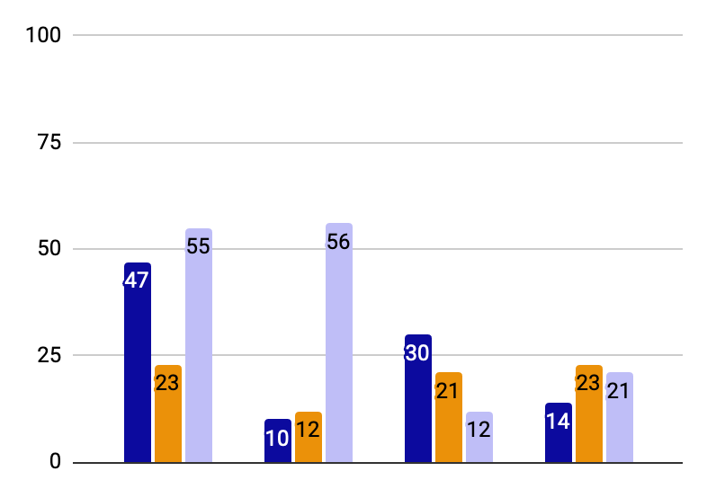
You can use this graph
Mercury
Mercury is the closest planet to the Sun
Jupiter
Jupiter is the biggest planet of them all
Saturn
Saturn was named after a Roman god
Follow the link in the graph to modify its data and then paste the new one here. For more info, click here

Slide 37
This is a map
USA
Russia
Despite being red, Mars is very cold
Neptune is the farthest planet from the Sun
India
China
Jupiter is the biggest planet of them all
Saturn is a gas giant and has several rings

Slide 38

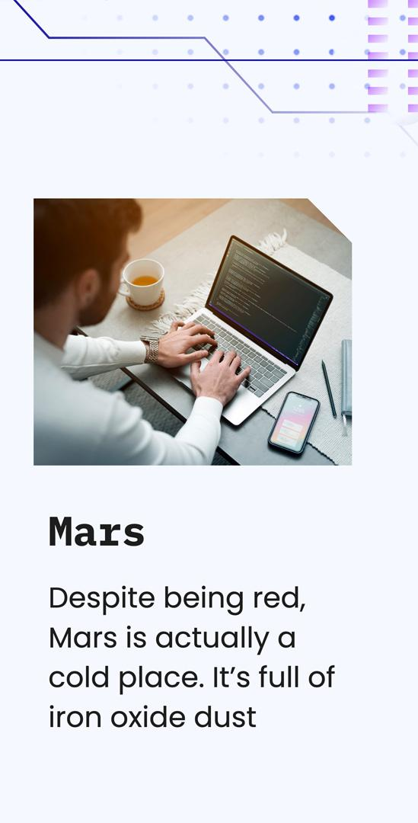
Mockups
You can replace the images on the screen with your own work. Just right-click on them and select “Replace image”

